Slide 2
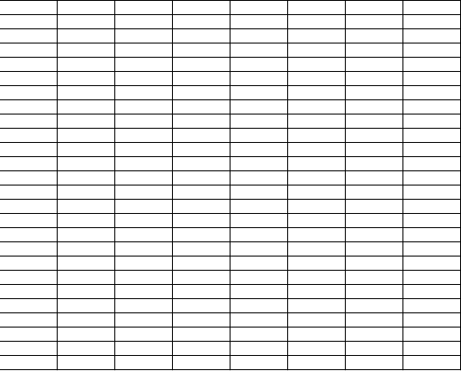
x = 2104
y = x
z = 3.1416
p = input(“Caeser said?”)
q = input(“dixerunt Caesaris?”)
Integer 2104
Floating Point 3.1416
String “Veni, Vidi, Vici”
String “Veni, Vidi, Vici”

Slide 3
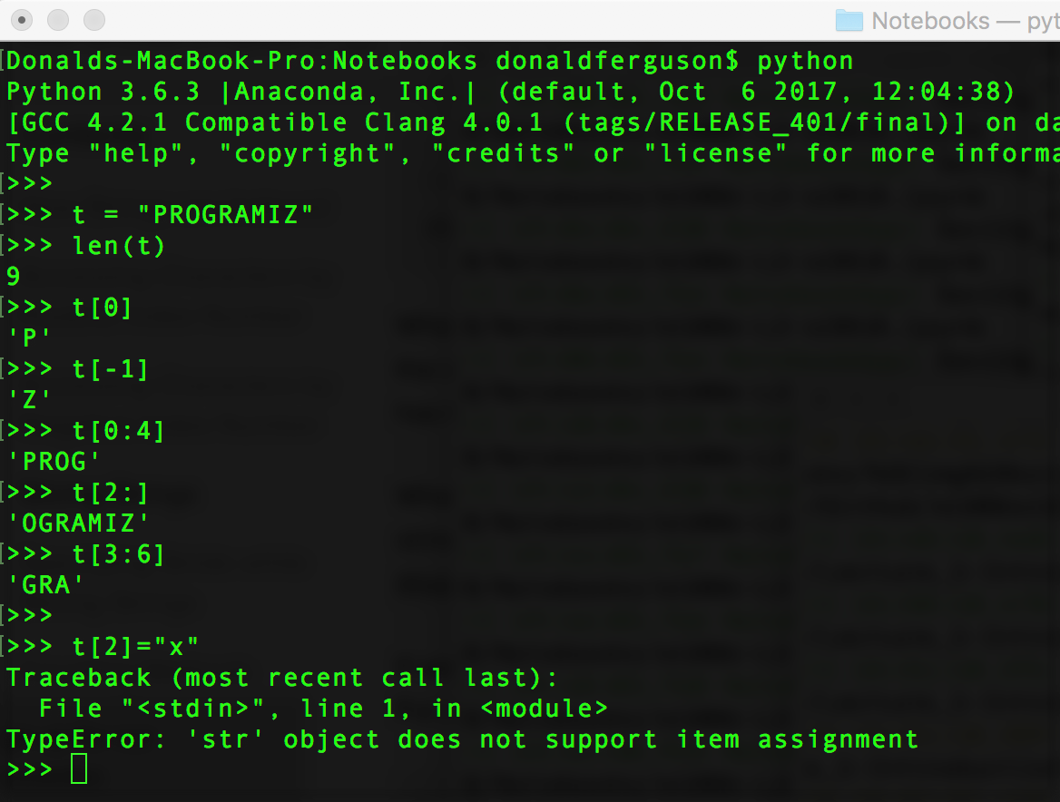
(Text) Sequence Object
This is what “immutable” means.

Slide 4
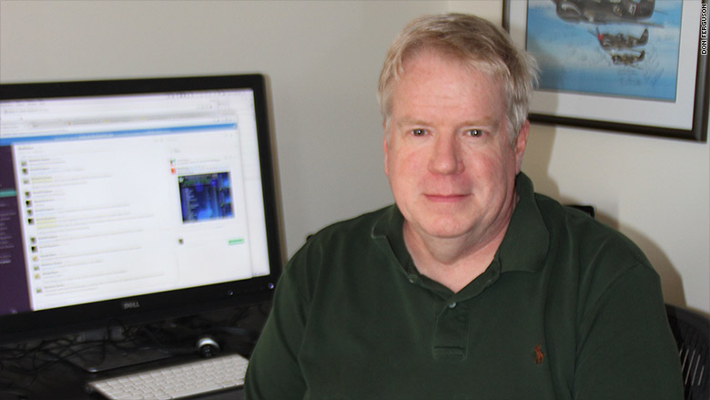
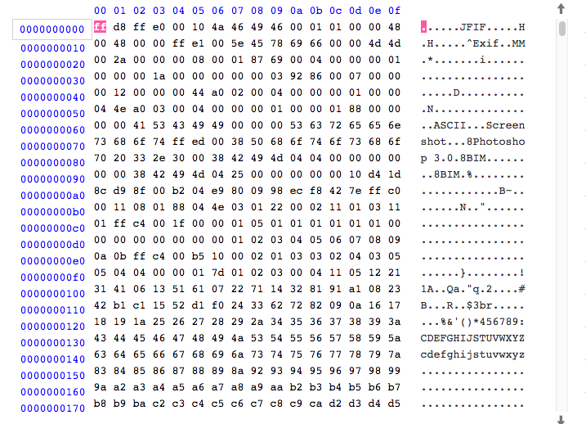
JPEG Image
Underlying File

Slide 5
Web Browser
REST/JSON
HTML, JPG, …
JavaScript
Database Connection
Content Rendering
Web Content Server
Files
Database Server

